Slide 1
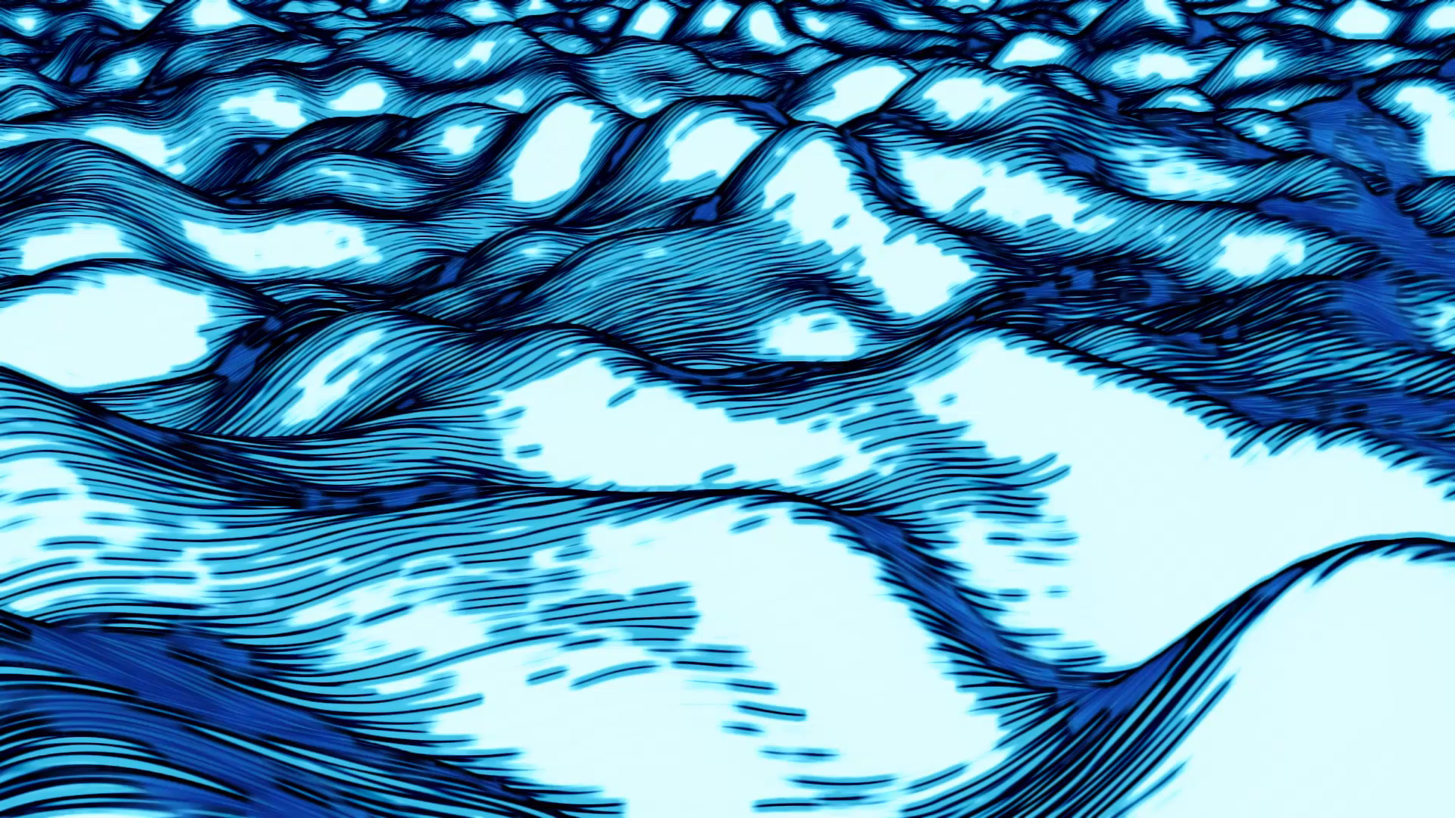
ERC-998 traceability
Pratical implementation of a traceability alghorithm, used for Composable NFTs deployed on an Ethereum Blockchain

Slide 2


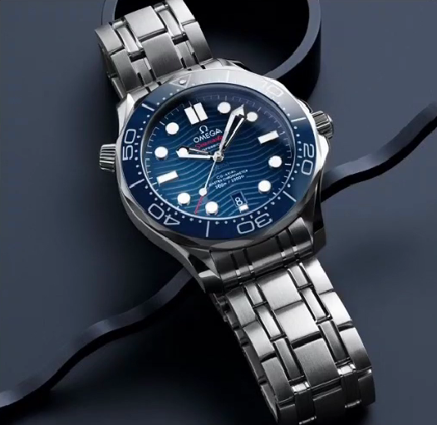
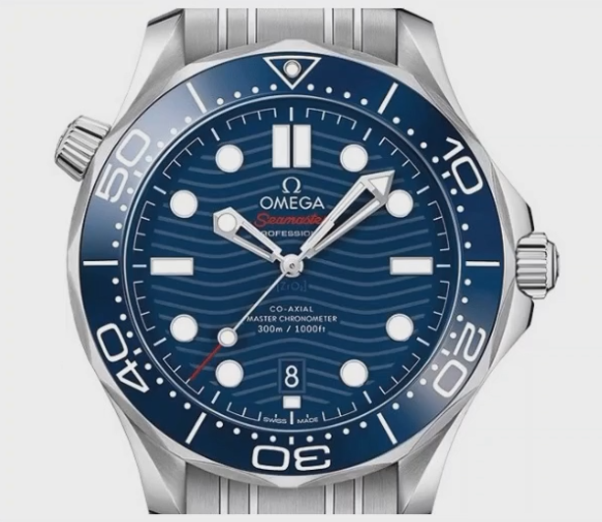
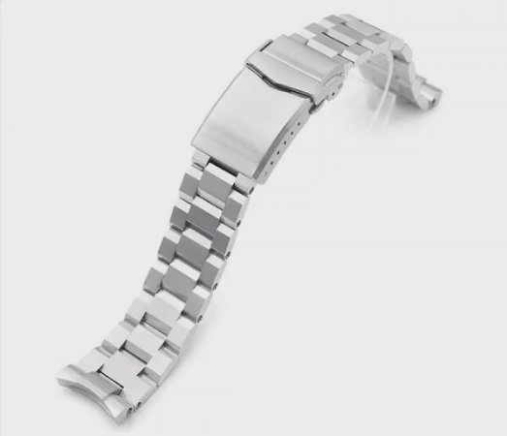
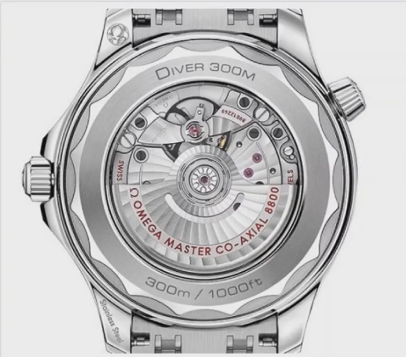







Introduction
Our main objective was to enable safe and immutable transactions for expensive watches, with assurances on both the watch and it’s components referring to a single element.

Slide 3
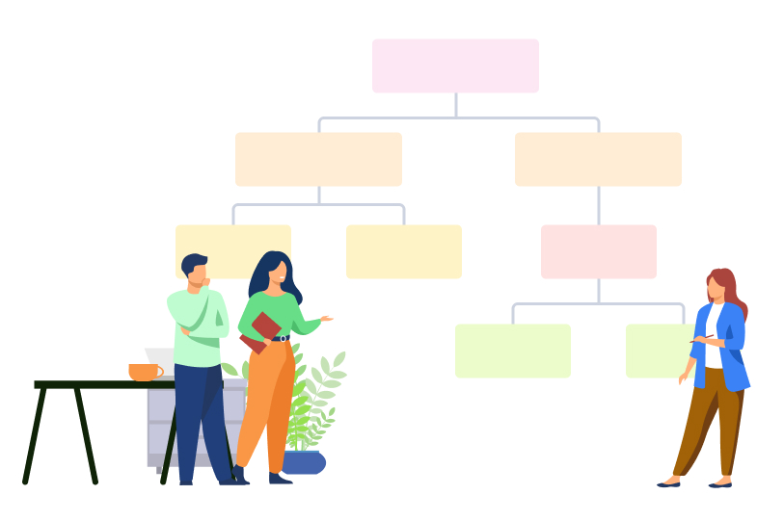
Project Decomposition
ERC-998 and ERC-721
Minting
IPFS
Transactions
Traceability
DApp

Slide 4





ERC-721
What is a Non Fungible Token?
DRIVER 300M CO AXIAL MASTER CHRONOMETER 42 MM
DRIVER 300M CO AXIAL MASTER CHRONOMETER 42 MM FACE
Why did we chose this?
Which tools did we use?
Which information does it store?

Slide 5
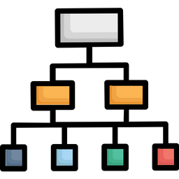
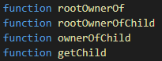
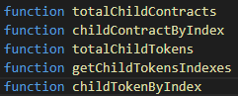
ERC-998
What does it add?
Top-Down or Bottom-up?
How does it do it?

Slide 6
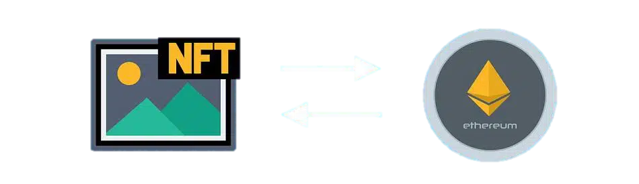
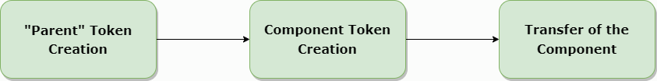
Minting
Minting is the operation by which a token is created.
How does the process take place?

Slide 7


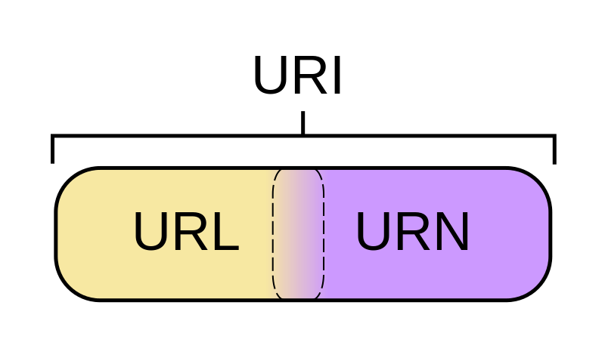
IPFS
IPFS is a set of protocols that uses a peer-to-peer network for storing and sharing data in a distributed file system.
What did we use?
What is saved in the Blockchain?

Slide 8
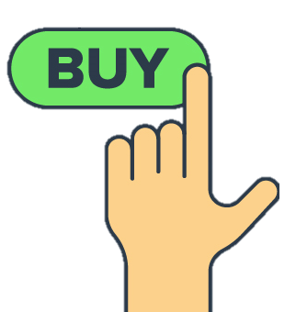
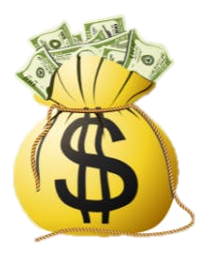
Purchases
The purchase function transfers the possession of a "parent" token from one user to another.
How does it work?
What did we use? Payable Functions

Slide 9
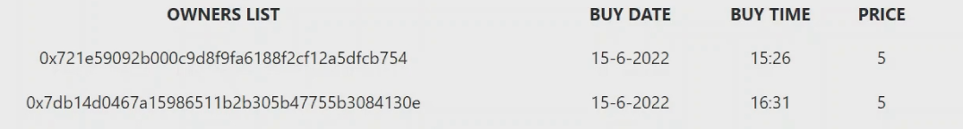









Traceability
Why do we need it?
Decentralization Immutability Transparency
What kind of operations do we want to trace?
What we implemented
What we could have implemented
Each watch token keeps trace of every one of it’s movements, storing the necessary data.
A new smart contract, which represent a transaction and is linked to the watch token

Slide 10






DApp
Structure
Homepage: catalogue of available and sold watches
Watch info page: info about watch and its components
Personal area: catalogue of user's watches
Front end languages: HTML, JavaScript
Functions to menage event trigged were built

Slide 11
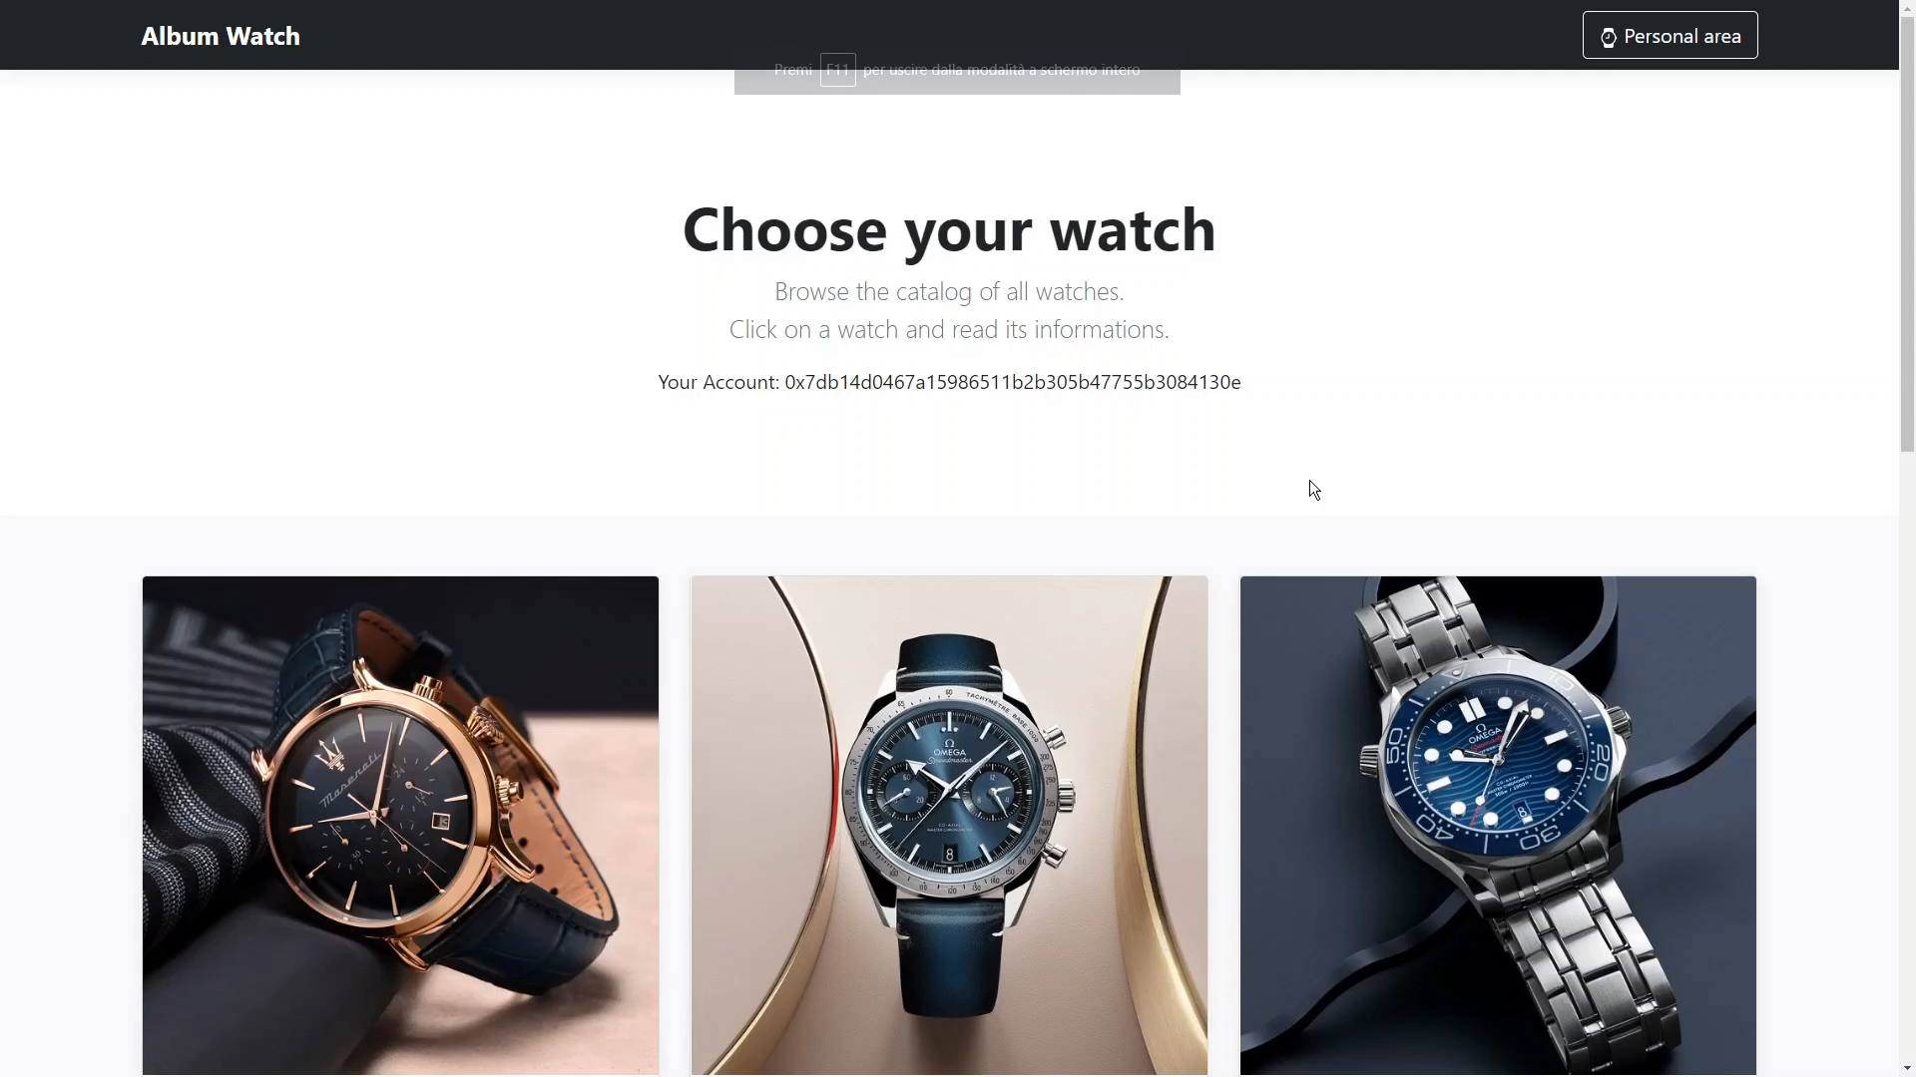
Demo

Slide 12








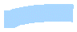




Future Developments
Marketplace Development
Better Management of Purchases
Adding Trading Between Clients
Accounting
Auctions
Global Device Porting
Better representation of the given products
Adding Documents to the Hierarchy

Slide 13

Questions and Links
Github Repository:
https://github.com/ManuelGabrielli/BlockchainProject2022

